Slide 1
SOFTWARE DESIGN AND ARCHITECTURE
THEORY LECTURE and PRACTICAL#09
STRUCTURAL DESIGN PATTERNS
(DECORATOR PATTERN)

Slide 2
INTENT
Attach additional responsibilities to an object dynamically. Decorators provide a flexible alternative to subclassing for extending functionality.
Also Known As: Wrapper
Notes:
To extend or modify the behaviour of ‘an instance’ at runtime decorator design pattern is used. Inheritance is used to extend the abilities of ‘a class’. Unlike inheritance, you can choose any single object of a class and modify its behaviour leaving the other instances unmodified.
In implementing the decorator pattern you construct a wrapper around an object by extending its behavior. The wrapper will do its job before or after and delegate the call to the wrapped instance.

Slide 3
Motivation
Sometimes we want to add responsibilities to individual objects, not to an entire class. A GUI toolkit, e.g. should let you add properties like borders or behaviors like scrolling to any user interface component. One way to add responsibilities is with inheritance. Inheriting a border from another class puts a border around every subclass instance. This is inflexible, however, because the choice of border is made statically. A client can't control how and when to decorate the component with a border.
A more flexible approach is to enclose the component in another object that adds the border. The enclosing object is called a decorator. The decorator conforms to the interface of the component it decorates so that its presence is transparent to the component's clients. The decorator forwards requests to the component and may perform additional actions (such as drawing a border) before or after forwarding.

Slide 4
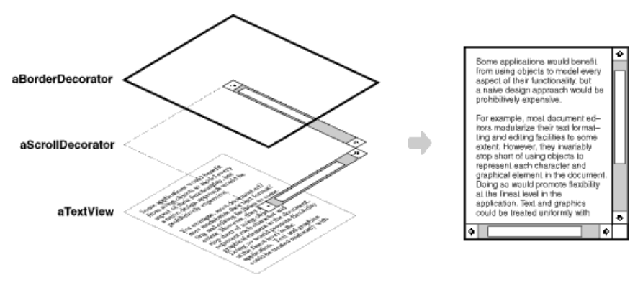

Slide 5
Applicability
Use Decorator:
to add responsibilities to individual objects dynamically and transparently, that is, without affecting other objects.
when extension by subclassing is impractical. Sometimes a large number of independent extensions are possible and would produce an explosion of subclasses to support every combination. Or a class definition may be hidden or otherwise unavailable for subclassing.

Slide 6
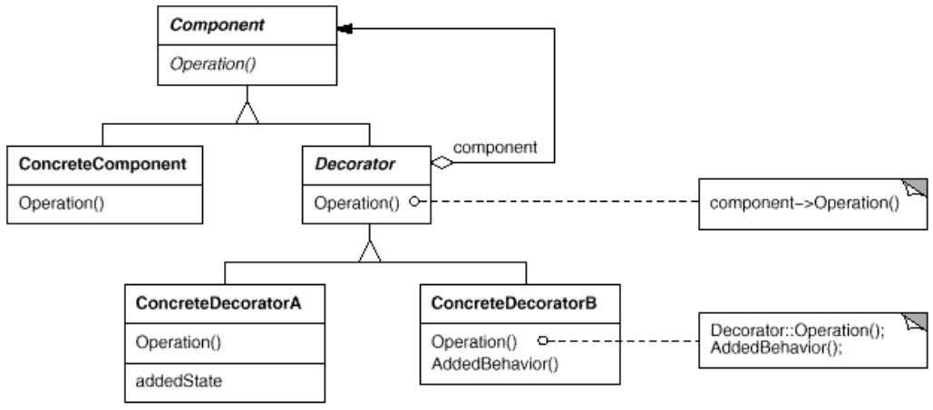
Structure

Slide 7
Participants
Component
defines the interface for objects that can have responsibilities added to them dynamically.
ConcreteComponent
defines an object to which additional responsibilities can be attached.
Decorator
maintains a reference to a Component object and defines an interface that conforms to Component's interface.
ConcreteDecorator
adds responsibilities to the component

Slide 8
Collaborations
Decorator forwards requests to its Component object. It may optionally perform additional operations before and after forwarding the request.

Slide 9
Consequences
More flexibility than static inheritance.
Avoids feature-laden classes high up in the hierarchy.
Lots of little objects.

Slide 10
Design of Decorator Pattern
You start with an interface which creates a blue print for the class which will have decorators. Then implement that interface with basic functionalities.
Create an abstract class that contains (aggregation relationship) an attribute type of the interface. The constructor of this class assigns the interface type instance to that attribute. This class is the decorator base class.
Now you can extend this class and create as many concrete decorator classes. The concrete decorator class will add its own methods. After / before executing its own method the concrete decorator will call the base instance’s method. Key to this decorator design pattern is the binding of method and the base instance happens at runtime based on the object passed as parameter to the constructor. Thus dynamically customizing the behavior of that specific instance alone.

Slide 11
Sample code
Icecream is a classic example for decorator design pattern. You create a basic icecream and then add toppings to it as you prefer. The added toppings change the taste of the basic icecream. You can add as many topping as you want. This sample scenario is implemented below.

Slide 12
Icecream (Interface)
public interface Icecream {
public String makeIcecream();
}

Slide 13
Following class is a concrete implementation of this interface. This is the base class on which the decorators will be added.
public class SimpleIcecream implements Icecream {
public String makeIcecream() {
return "Base Icecream";
}
}

Slide 14
Following class is the decorator class. It is the core of the decorator design pattern.
abstract class IcecreamDecorator implements Icecream {
protected Icecream specialIcecream;
public IcecreamDecorator(Icecream specialIcecream) {
this.specialIcecream = specialIcecream;
}
public String makeIcecream() {
return specialIcecream.makeIcecream();
}
}
Notes:
It contains an attribute for the type of interface. Instance is assigned dynamically at the creation of decorator using its constructor. Once assigned that instance method will be invoked.

Slide 15
Following two classes are similar. These are two decorators, concrete class implementing the abstract decorator.
public class NuttyDecorator extends IcecreamDecorator {
public NuttyDecorator(Icecream specialIcecream) {
super(specialIcecream);
}
public String makeIcecream() {
return specialIcecream.makeIcecream() + addNuts();
}
private String addNuts() {
return " + cruncy nuts";
}
}
Notes:
When the decorator is created the base instance is passed using the constructor and is assigned to the super class. In the makeIcecream method we call the base method followed by its own method addNuts(). This addNuts() extends the behavior by adding its own steps.

Slide 16
public class HoneyDecorator extends IcecreamDecorator {
public HoneyDecorator(Icecream specialIcecream) {
super(specialIcecream);
}
public String makeIcecream() {
return specialIcecream.makeIcecream() + addHoney();
}
private String addHoney() {
return " + sweet honey";
}
}

Slide 17
Following is a simple icecream and decorated that with nuts and on top of it with honey.
public class TestDecorator {
public static void main(String args[]) {
Icecream icecream = new HoneyDecorator(new NuttyDecorator(new SimpleIcecream()));
System.out.println(icecream.makeIcecream());
}
}

Slide 18
Output
Base Icecream + cruncy nuts + sweet honey

Slide 19
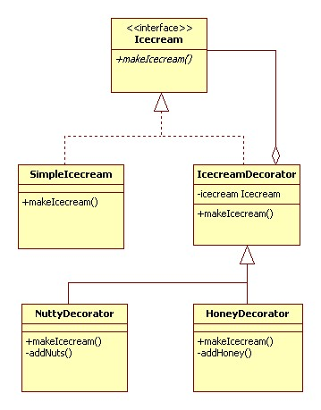
UML of Example

Slide 20
Known uses
Many object-oriented user interface toolkits use decorators to add graphical embellishments to widgets.
Different responsibilities such as compression and reducing to characters can be done with this pattern.

Slide 21
Benefits:
Decorator design pattern provide more flexibility than the standard inheritance. Inheritance also extends the parent class responsibility but in a static manner. However decorator allows doing this in dynamic fashion.
Drawback:
Code debugging might be difficult since this pattern adds functionality at runtime.

Slide 22
JAVA API EXAMPLES
There are various live examples of decorator pattern in Java API.
java.io.BufferedReader;
java.io.FileReader;
java.io.Reader;
If we see the constructor of the BufferedReader then we can see that the BufferedReader wraps theReader class by adding more features e.g. readLine() which is not present in the reader class. We can use the same format like the above example on how the client uses the decorator pattern new BufferedReader(new FileReader(new File(“File1.txt”)));

Slide 23
PRACTICAL 09 TASK:
Implement the decorator pattern for any scenario of your choice. Also include the relevant class diagram.

